Slide 1


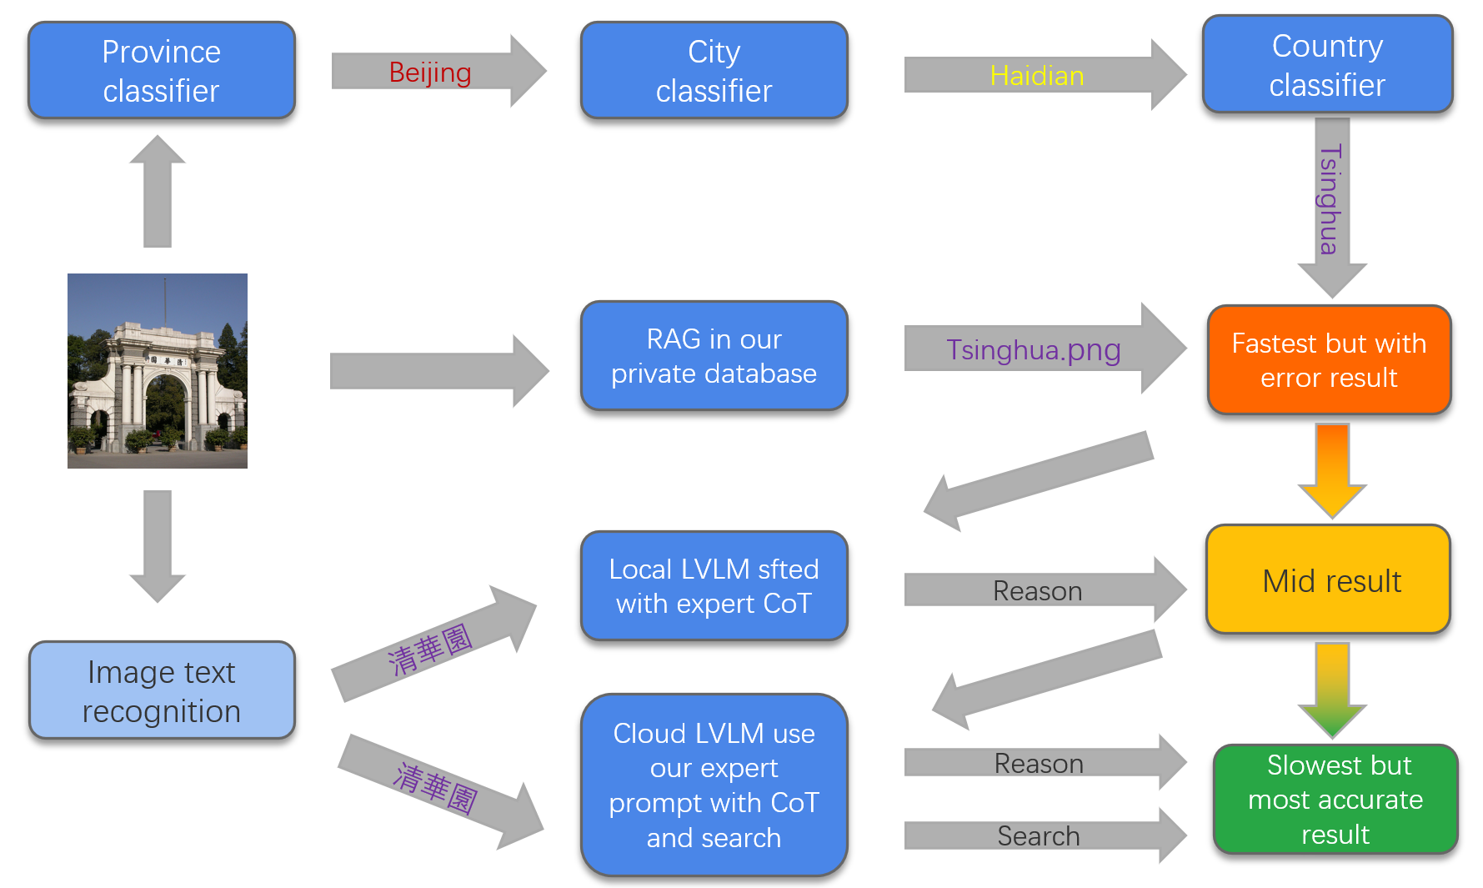
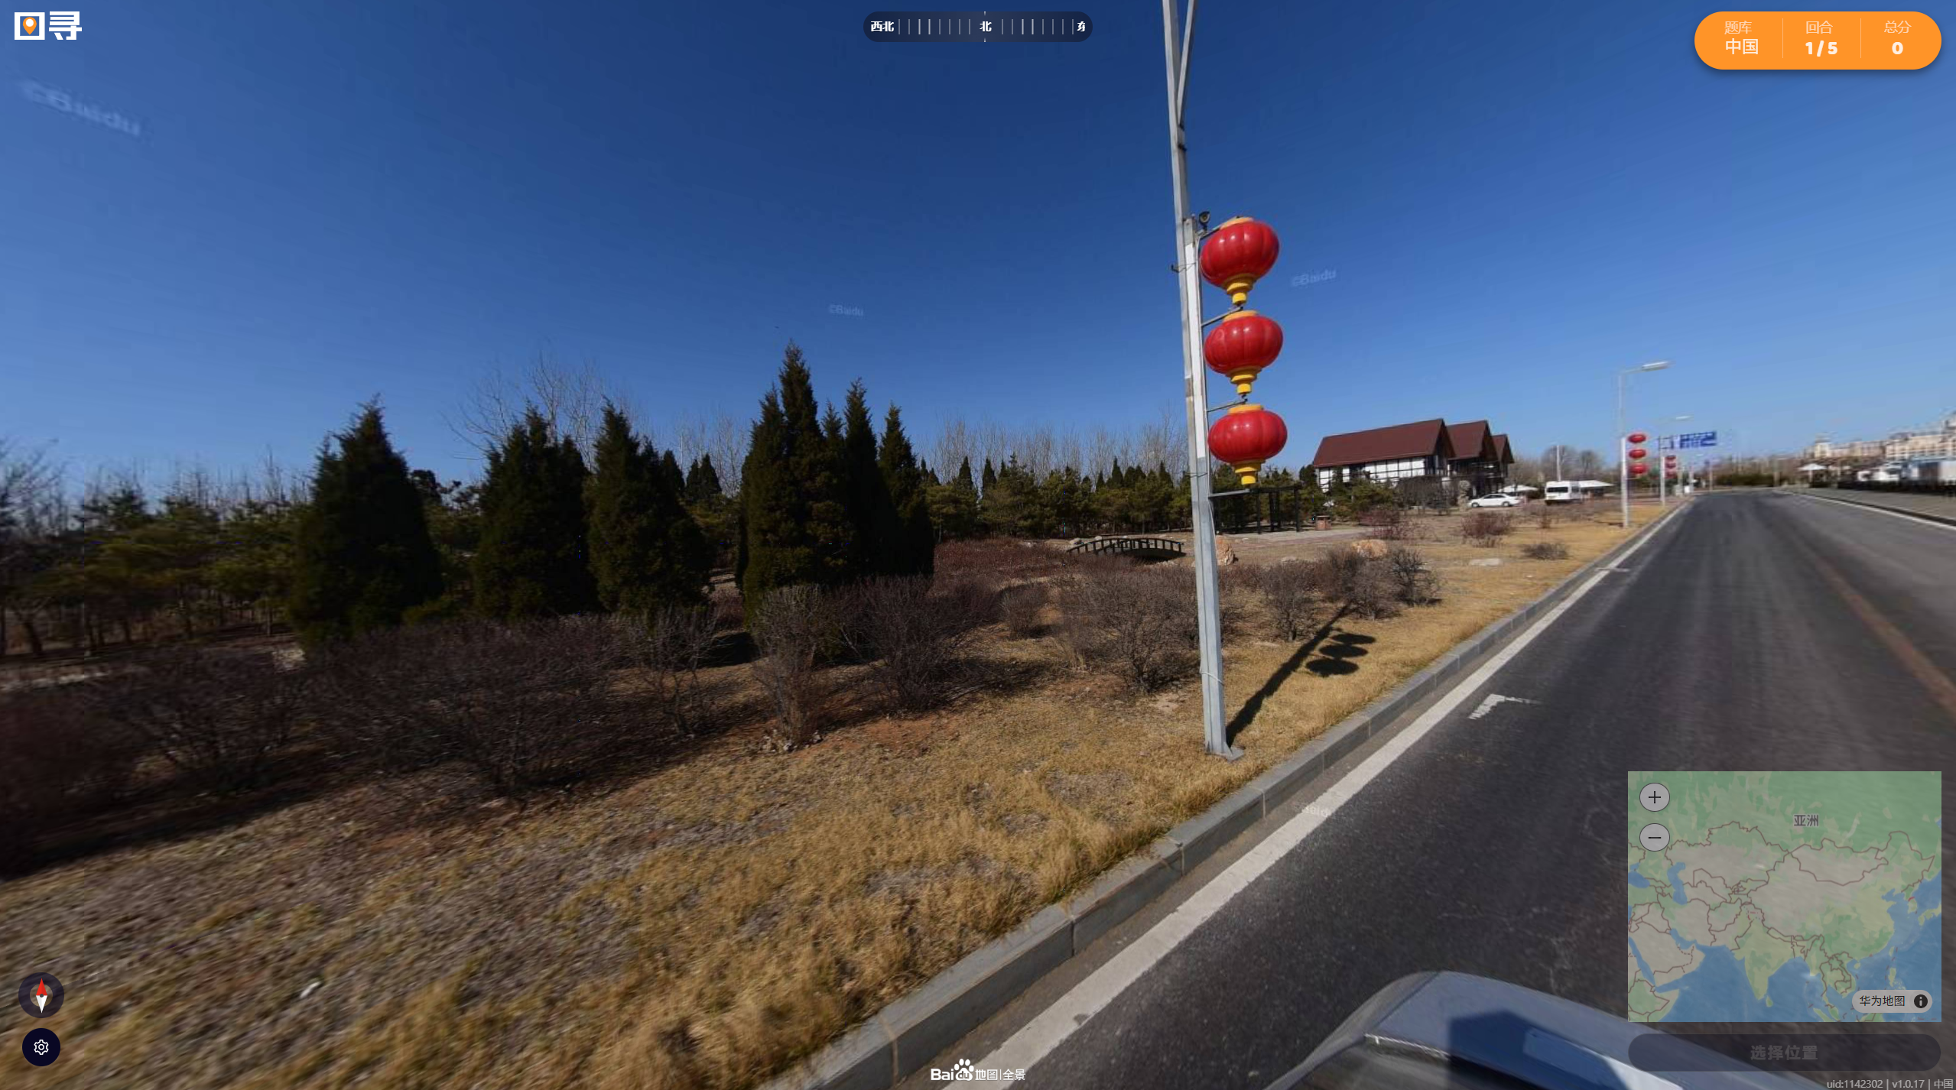
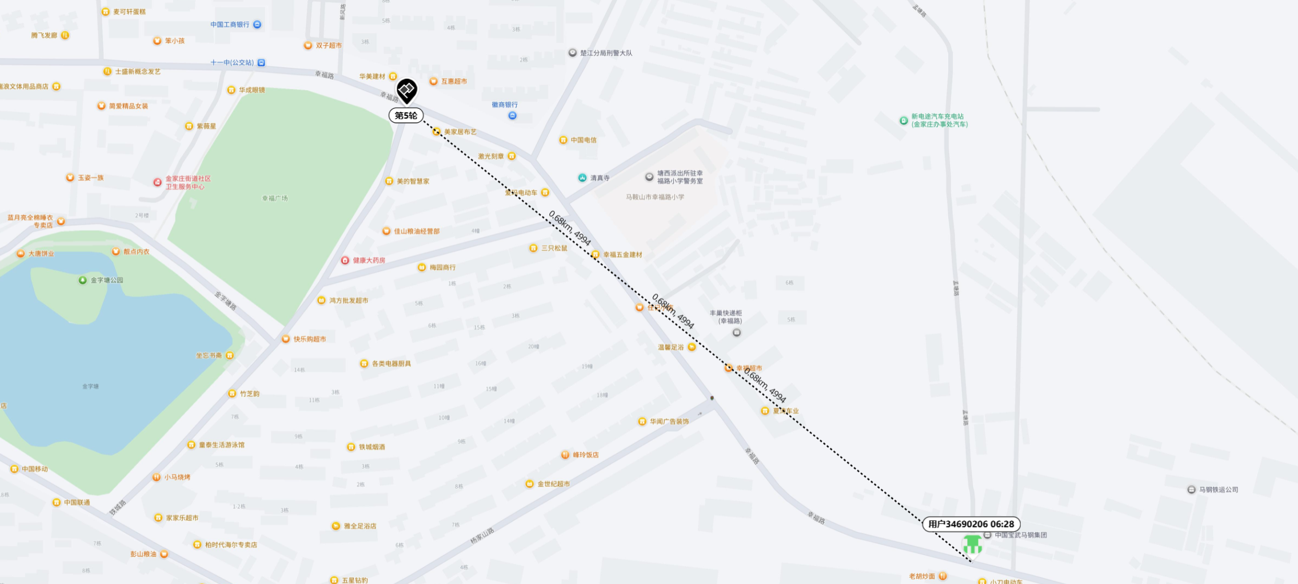
Image2Geolocation within China
Shi Guotao Qi Langrui Dong Yiqi
IIIS, Tsinghua University
Abstract
Our project develops an Image2Geolocation system which combines multiple methods and capable of predicting the geographic location of an input image within China, which has strong potential for real-world applications in Open Source Intelligence, an important area of Intelligence studies.
Motivation and Introduction
The task of image2geolocation has gained significant interest before, but previous studies often focus on global image2geolocation(e.g. geoguessr) tasks and traditional CV approaches. Recently, the strong ability of gpt-O3 in image2geolocation raised public’s awareness and reminded us of the huge potential of applying LVLMs with CoT in this task. Also, the popularity of the game called TuXun(see Figure 1) which focus on Image2Geolocation within China impressed us. So, we propose a hybrid architecture that leverages both fast, discriminative models and powerful generative/inferential capabilities to pinpoint image locations within China.
Figure 2: Our system Architecture
Results and future direction
Combination of specialized modules and advanced LVLMs leads to more precise geolocation. Meanwhile multiple sources (visual, textual, database) provide resilience against ambiguous or low-quality images and offers a trade-off between speed and comprehensive accuracy. In the future, we will work better on database expansion, continuously enlarge and refine the RAG image database with diverse, high-quality geolocated images from China. Also, we will develop and integrate of on-device SFT model with more training data and make a user-friendly interface.
Figure 1: a classic TuXun game interface
System Architecture
Our system processes an input image through several interconnected modules to determine its geographical origin (See Figure 2), it combines traditional CV approaches and modern LVLM with CoT. Also Image text recognition block is used considering significant high frequency and importance of Chinese characters appearance in China Image2Geolocation. We also used our new developed private dataset to solve the lack of data for image2geolocation within China.
Figure 3: Apply our system in one round of TuXun exercise
Reference
[1] Zhou, Zhongliang, et al. "Img2Loc: Revisiting image geolocalization using multi-modality foundation models and image-based retrieval-augmented generation." Proceedings of the 47th International ACM SIGIR Conference on Research and Development in Information Retrieval. 2024.
[2] Haas, Lukas, et al. "Pigeon: Predicting image geolocations." Proceedings of the IEEE/CVF Conference on Computer Vision and Pattern Recognition. 2024.
[3] Liu, Yi, et al. "Image-Based Geolocation Using Large Vision-Language Models." arXiv preprint arXiv:2408.09474 (2024).
[4] geoguessr https://www.geoguessr.com/, 2025
[5] Tuxun. https://tuxun.fun/, 2025
[6] CLIP https://github.com/openai/CLIP, 2021
Deep Learning 2025 Spring

